Slide 1


Grooming the Hairball - How to Tidy up Network Visualizations?
Hans-Jörg Schulz¹, Christophe Hurter²
VIS Tutorial 2013
University of Rostock, Rostock, Germany
French Civil Aviation University, Toulouse, France
Notes:
75 minutes
Remove abreviation
Voc make sparser: clarsemer
1 slide per minute
Prepare source code
What is the main idea but why is it different?

Slide 2
Part II: EDGE SET SIMPLIFICATION
Speaker: Christophe Hurter

Slide 3
Objectives
At the end of the part II, you will be able to explain:
Algorithmic techniques to reduce edge clutter
Interaction techniques to reduce edge clutter
More specifically Edge Bundling (EB) techniques
And you will be able to implement at least two EB techniques (Hierarchical Edge Bundling and Kernel Density Estimation Edge Bundling)
Notes:
In this part of the tutorial, we will discuss algorithms and interactive
techniques to reduce edge clutter in visualizations. These techniques
mainly rely on edge-bundling algorithms which have been
subject to an increased interest in active research and a number of
improvements and enhancement in recent years.

Slide 4
Outlines
Recall of the Dataflow model
Taxonomy of edge simplification
Edge simplification techniques
Data Level
Geometry Level
Image Level
Notes:
edge simplification can occur: the data level, the
geometry level, and the image level.

Slide 5
Taxonomy of edge simplification
Give a structure to better understand the design space
Give criteria to better characterize existing techniques
Give a tool to explore available technique (detection of new unexplored technique)

Slide 6
InfoVis pipeline
Data Level (Filtering)
Geometry Level (Mapping)
Image Level (Rendering)
[ S.K. Card, J. Mackinlay, B. Shneiderman, 1998]
Notes:
S.K. Card, J. Mackinlay, B. Shneiderman,
Information Visualization Readings in Information Visualization: Using Vision to Think. Morgan Kaufman 1998.

Slide 7
Recall: taxonomy
Network Simplification
WHEN?
Data Level (Filtering)
Geometry Level (Mapping)
Image Level (Rendering)
Detection
Determine where clutter occurs
Reduction
Remove the detected clutter by simplifying the network
HOW?
Interaction
Interactively refine the result

Slide 8
About the Tutorial Topic
A Conceptual Framework to Solve this Problem
Network Simplification
WHEN?
Data Level (Filtering)
Geometry Level (Mapping)
Image Level (Rendering)
Detection
Simplify the network before the actual layout starts
Simplify the network during the layout computation
Simplify the network after the layout has been generated
HOW?
Reduction
Interaction

Slide 9
About the Tutorial Topic
A Conceptual Framework to Solve this Problem
Network Simplification Examples
WHEN?
Data Level (Filtering)
Geometry Level (Mapping)
Image Level (Rendering)
Detection
Compute DoI values for elements
Determine con-fluence of edges
Register overplot-ting in each Pixel
HOW?
Reduction
Contract elements with low DoIs
Bundle edges with high pairwise confl.
Merge overplotted Pixels into a splat
Interaction
Adjust DoI threshold to steer the degree of reduction
Use lens to locally un-bundle edges for detailed inspection
Adapt the range of influence of the splat function (σ)

Slide 10
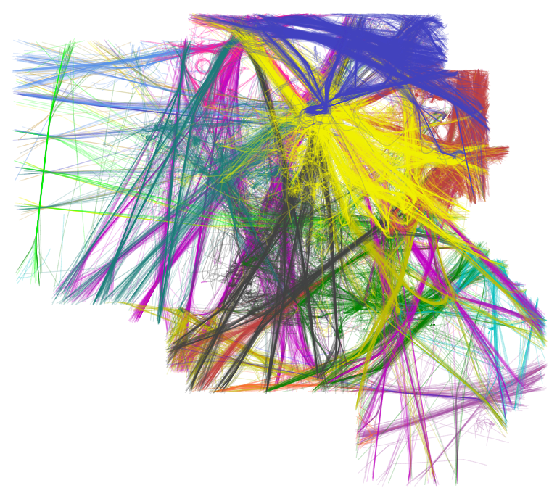
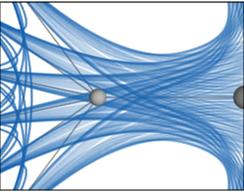
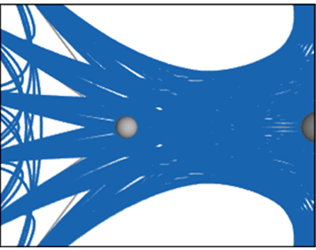
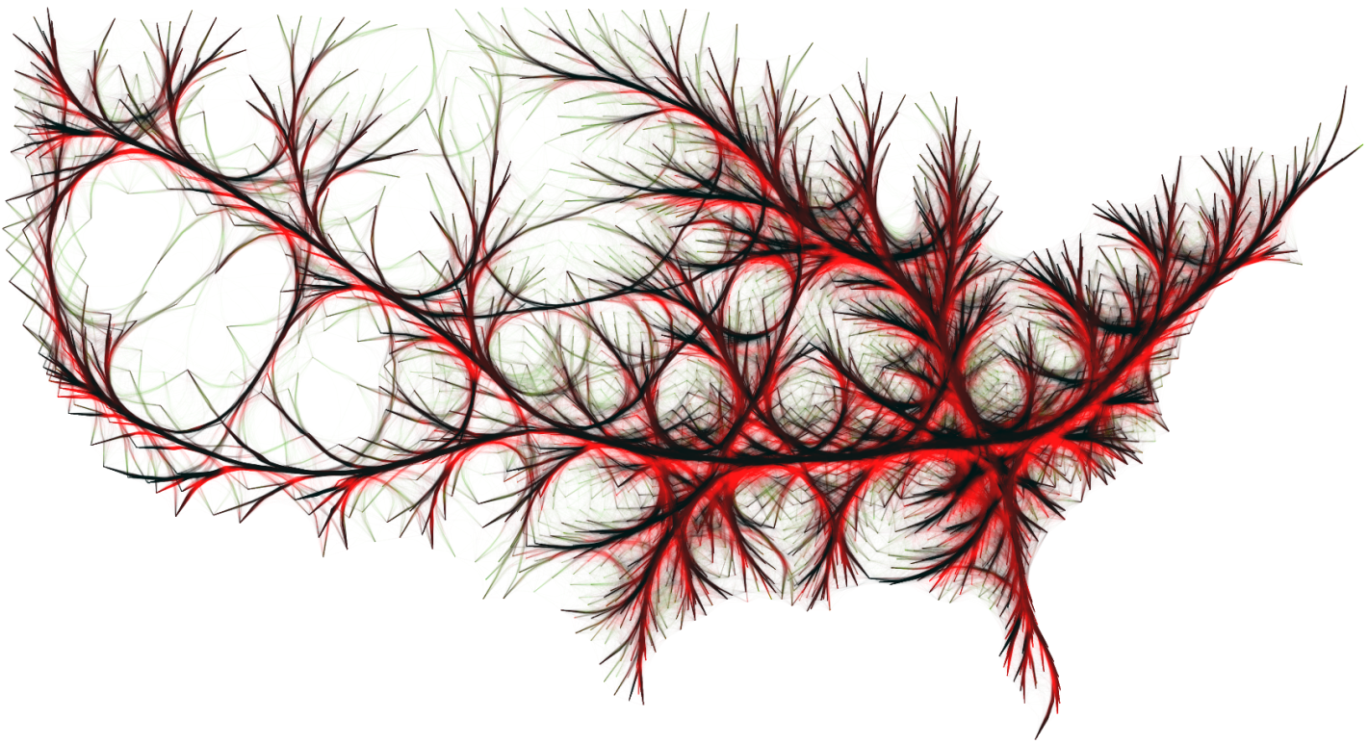
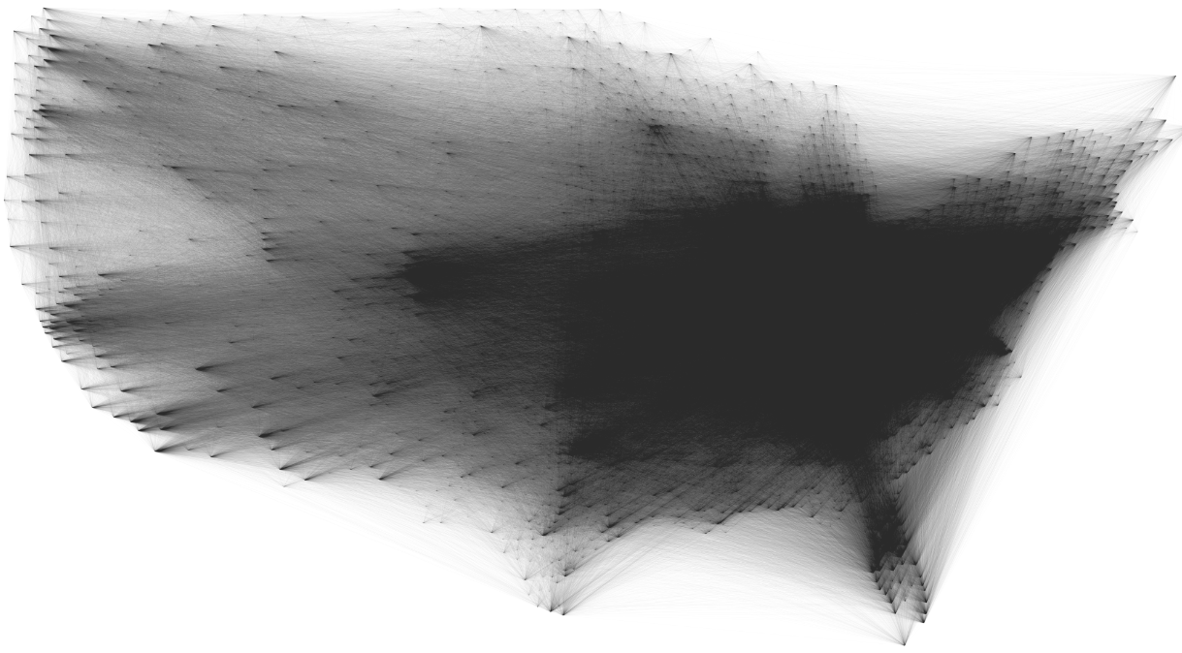
Instances
Data Level (Filtering)
Image Level (Rendering)
Geometry Level (Mapping)
Notes:
Give example of existing remarcable techniques
Teaser

Slide 11
Part II: EDGE SET SIMPLIFICATION Data Level (filtering)
WHEN?
Data Level (Filtering)
Geometry Level (Mapping)
Image Level (Rendering)
Notes:
Clustering methods
Interactive methods
Filtering methods

Slide 12
Small world issue
The small-world experiment comprised several experiments conducted by Stanley Milgram and other researchers examining the average path length for social networks of people in the United States.
[Watts 1999]
Notes:
Edges can be filtered with Centrality Based Visualization of Small World Graphs [40],
The small-world experiment comprised several experiments conducted by Stanley Milgram and other researchers examining the average path length for social networks of people in the United States.
The experiments are often associated with the phrase "six degrees of separation", although Milgram did not use this term himself.
Video and demo on the node part with the Frank Van ham and Jark van wick work :
Interactive Visualization of Small World Graphs

Slide 13
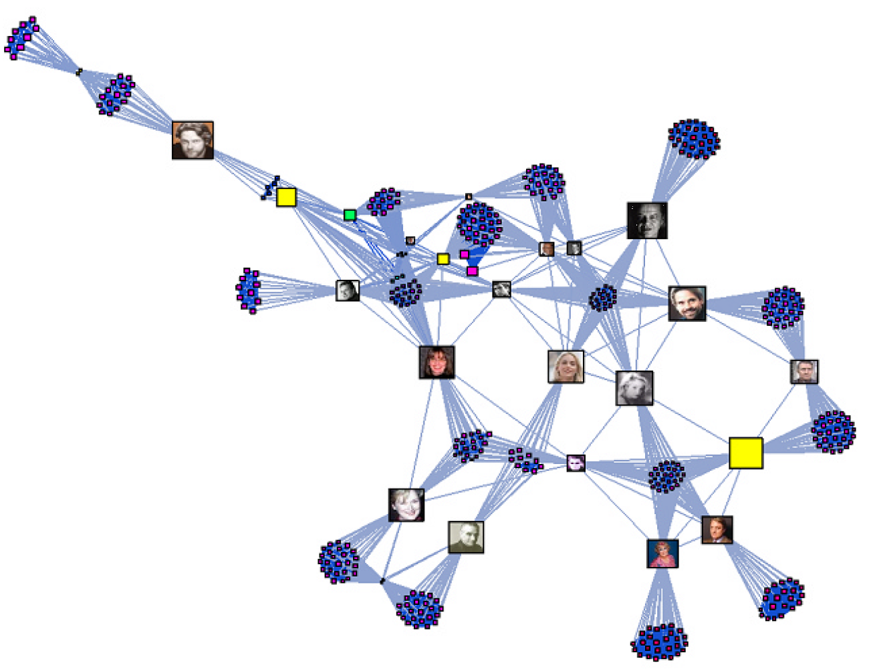
Multiscale Visualisation of Small World Networks
[Auber et al. Infovis 2003]
[Van Ham and Van Wijk, Infovis 2004] -> nodes simplification
Notes:
Metric to identify weakest edges in the small workd network
Break down a graph in smaller and highy connected sub network
Use this metric with a semantic zooming
Metric provided by Alpert an Kahng 1995 and Watts 1999
van Ham, van Wijk, Edge simplification : Interactive Visualization of Small World Graphs. Infovis 2004????

Slide 14
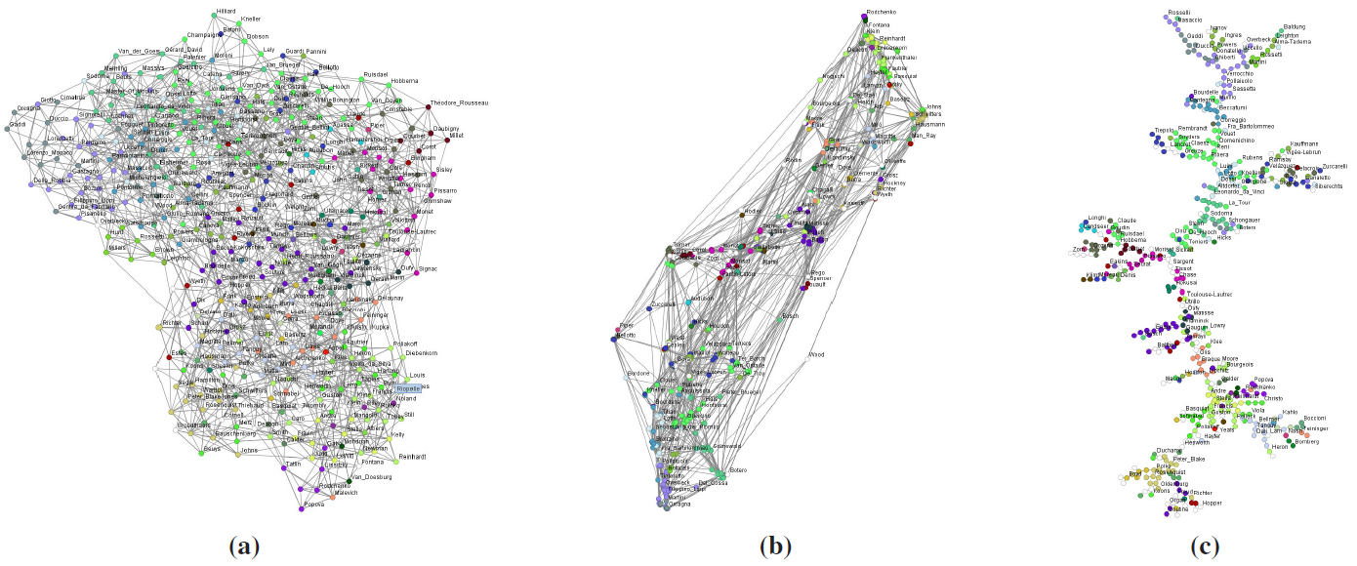
Centrality Based Visualization of Small World Graphs
[van Ham and Wattenberg , Eurovis 08]
Notes:
Different layouts of the same graph, representing 500 artists and their mutual influences. Coloring is done by artistic
movement. (a) Shows a the result after a standard force directed layout (b) Shows the result after a force directed layout using a
Lin-Log model [Noa05] (c) Shows the result after computing a minimum edge centrality spanning tree and performing a force
directed layout.
Many real world graphs have small world characteristics, that is, they have a small diameter compared to the number of nodes and exhibit a local cluster structure. Examples are social networks, software structures, bibliographic references and biological neural nets. Their high connectivity makes both finding a pleasing layout and a suitable clustering hard. In this paper we present a method to create scalable, interactive visualizations of small world graphs, allowing the user to inspect local clusters while maintaining a global overview of the entire structure. The visualization method uses a combination of both semantical and geometrical distortions, while the layout is generated by a spring embedder algorithm using recently developed force model. We use a cross referenced database of 500 artists as a running example

Slide 15
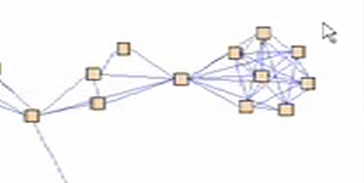
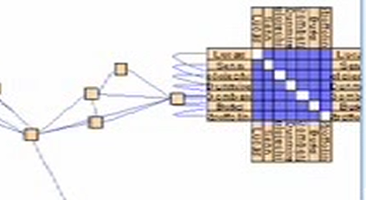

Data Level: interactive Methods
systems, such as Node Trix, compact dense subgraphs into matrix representations.
[Henry et al. , InfoVis 2007]
Notes:
Hybrid visualization: node link and adjency matrix
(Video)

Slide 16
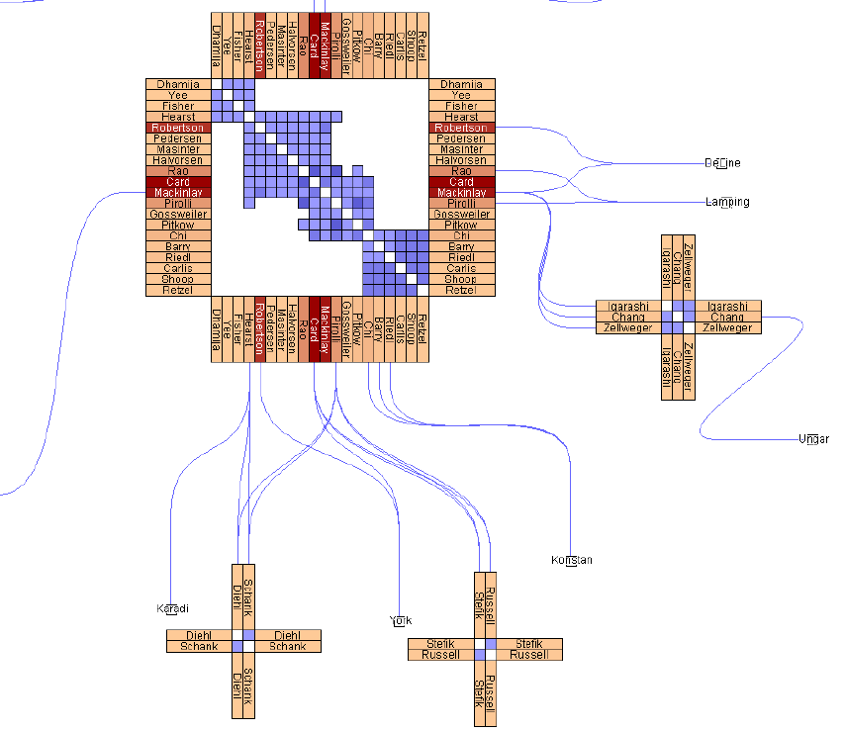
[Henry et al. 2007]
Notes:
Infovis paper citation between authors.
Add visual variable usages like intensity / color to code information
Color on axis codes the number of citations of each authors
Color whithin the matrix code the strengh of the collaboration

Slide 17
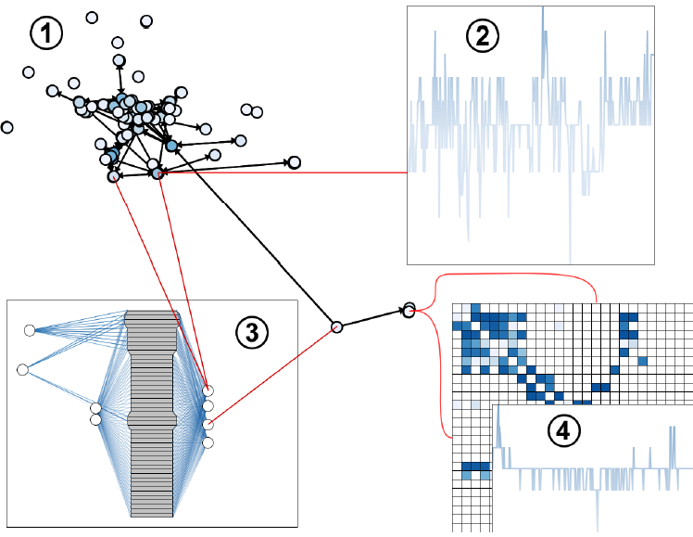
In Situ Exploration of Large Dynamic Networks
[ Hadlak et al. TVCG 2011]
Notes:
Video
Change the perspective of the data, temporal graph
Fig. 1. Example showing our in situ strategy. 1: base visualization
showing a node-link layout of the supergraph and multiple embedded
visualizations. 2: in situ visualization showing a complexity plot for the
underlying subgraph. 3: in situ visualization showing a 1.5D visualization
of the underlying subgraph, connecting links are overlaid in red by
the base visualization. 4: recursive use of in situ visualization to show a
complexity plot for a subgraph selected in a matrix view.
S. Hadlak, H. Schulz, and H. Schumann, In Situ Exploration of Large Dynamic Networks, TVCG 2011
The analysis of large dynamic networks poses a challenge in many fields, ranging from large bot-nets to social networks.
As dynamic networks exhibit different characteristics, e.g., being of sparse or dense structure, or having a continuous or discrete
time line, a variety of visualization techniques have been specifically designed to handle these different aspects of network structure
and time. This wide range of existing techniques is well justified, as rarely a single visualization is suitable to cover the entire visual
analysis. Instead, visual representations are often switched in the course of the exploration of dynamic graphs as the focus of analysis
shifts between the temporal and the structural aspects of the data. To support such a switching in a seamless and intuitive manner,
we introduce the concept of in situ visualization – a novel strategy that tightly integrates existing visualization techniques for dynamic
networks. It does so by allowing the user to interactively select in a base visualization a region for which a different visualization
technique is then applied and embedded in the selection made. This permits to change the way a locally selected group of data
items, such as nodes or time points, are shown – right in the place where they are positioned, thus supporting the user’s overall
mental map. Using this approach, a user can switch seamlessly between different visual representations to adapt a region of a base
visualization to the specifics of the data within it or to the current analysis focus. This paper presents and discusses the in situ
visualization strategy and its implications for dynamic graph visualization. Furthermore, it illustrates its usefulness by employing it for
the visual exploration of dynamic networks from two different fields: model versioning and wireless mesh networks.

Slide 18
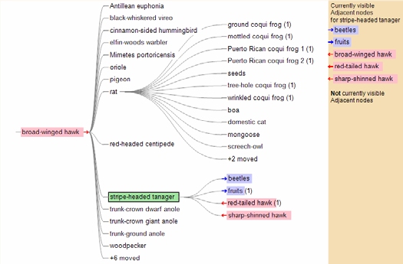
TreePlus: Interactive Exploration of Networks with Enhanced Tree Layouts
[Lee et al. TVCG 2006]
Notes:
Video
Dense layout and occlusion makes it hard to explore and undrstna and interact with.
use a guiding metaphor of “Plant a seed and watch it grow.” It allows users to start with a node and expand the graph as needed, which complements the classic overview techniques than can be effective at - but often limited to - revealing clusters.
Regarding filtering techniques, direct queries can filter out edges with multivariate criteria. or explored with spanning tree as used in TreePlus [25].
Show adjencent nodes and directions

Slide 19
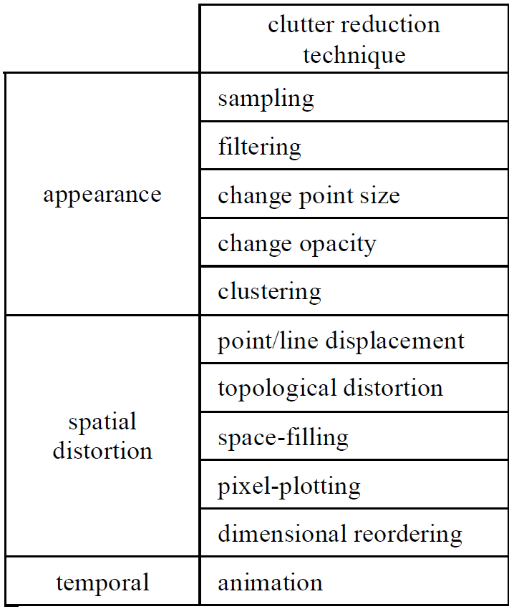
Data Level: clustering Methods
Clutter Reduction Techniques
G. Ellis and A. Dix TVCG 2007
Notes:
Our taxonomy is adapted from Ellis and Dix
G. Ellis and A. Dix. A taxonomy of clutter reduction for information
visualisation. IEEE TVCG, 13(6):1216–1223, 2007
Aggregation and edge clustering methods are given in [7].
Give one exemple
The first group, appearance, lists those techniques which tend to affect the look of the data item.
Change point size, change opacity are self-explanatory; sampling and filtering are included as they have a dramatic affect on the appearance – the item disappears!
Spatial distortion includes techniques that displace the point or line in some way. The first technique in this group, point/line displacement adjusts the position of each data item, whereas the next
technique, topological distortion stretches the background, either non-uniformly (e.g. Fish-eye) or uniformly (e.g. zoom) taking the
data items with it. Space-filling is essentially a non-overlapping rearrangement of large, rectangular points, often driven by a
particular structure (e.g. Treemaps). Pixel-plotting techniques plot data items as single pixels in order to pack as much data as possible
into the available screen space. Dimensional reordering is perhaps a special case in which the attribute axes of parallel coordinate plots
are rearranged and hence can be thought of as a spatial distortion. Lastly, animation techniques which are mentioned in the literature in relation to clutter reduction fall under temporal techniques.

Slide 20
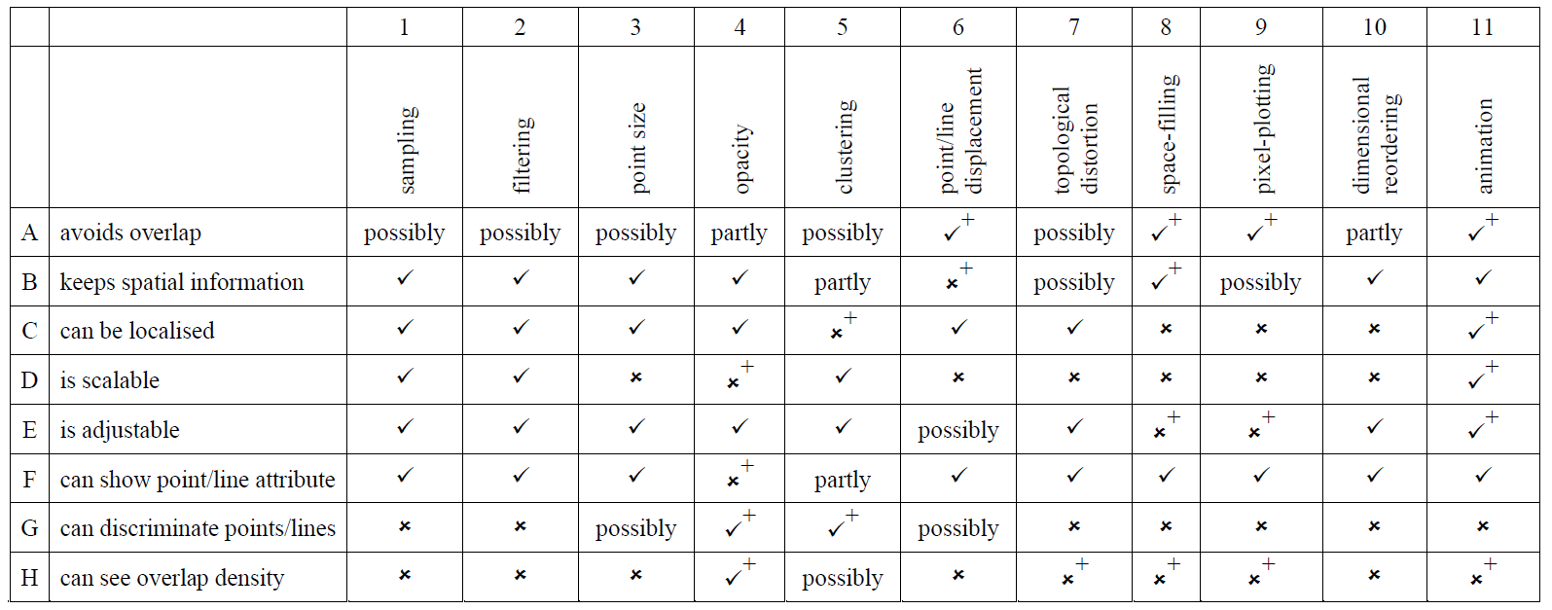
Clutter Reduction Taxonomy
G. Ellis and A. Dix. A taxonomy of clutter reduction for information visualisation. IEEE TVCG, 13(6):1216–1223, 2007
Notes:
Read one exemple.
Detail techniques:
Tree Plus
Nod trix

Slide 21
Part II: EDGE SET SIMPLIFICATION Geometry level
WHEN?
Data Level (Filtering)
Geometry Level (Mapping)
Image Level (Rendering)
Notes:
Clustering methods
Interactive methods
Filtering methods

Slide 22
Us migration
Original
545 881 edges

Slide 23
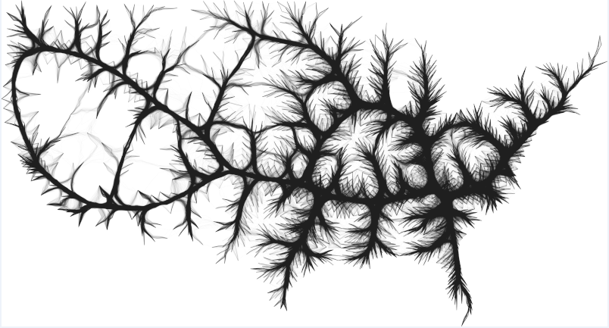
Bundled

Slide 24
Shading
Us migration
Kernel Density Based Edge Bundling
22 million vertexes

Slide 25
Outline
EB definition
History of EB: flow maps
HEB
GBEB, Winding Road
FDEB, mingle, sideknot
SBEB
KDEEB
Interaction techniques

Slide 26

Flow map/ Sankee graphs
Sankey diagrams are a specific type of flow diagram, in which the width of the arrows is shown proportionally to the flow quantity.
Notes:
Introduction – The Why, When, and How
Graph, trajectories
Famous Sankey diagram of Napoleon's invasion of Russia.
MINAR (french cartographer)

Slide 27
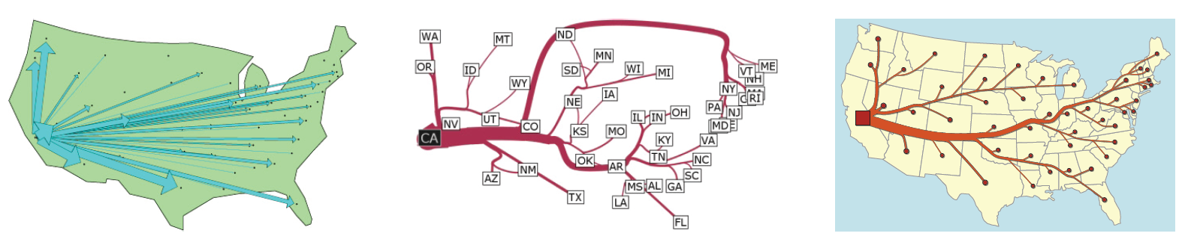
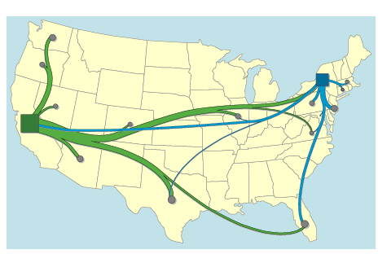
[Tobler 1987]
[Verbeek et al. infovis 11]
[Phan et al. InfoVis 05 ]
[Nocaj and Brandes, Stub Bundling and Confluent Spirals for Geographic Networks Graph Drawing 13]
Notes:
Maps illustrating migration from California 1995–2000.
Top: flow maps, Tobler [1, 22] (arrows of varying width), Phan et al. [16] (edgebundeling with crossings), and our output.
W. Tobler. Experiments in migration mapping by computer. The American Cartographer, 14(2):155–163, 1987.
D. Phan, L. Xiao, R. Yeh, P. Hanrahan, and T. Winograd. Flow map layout. In Proc. IEEE Symposium on Information Visualization (INFOVIS ’05), pages 219–224, 2005.
Bottom: subgraphs of the bundled complete migration graph, Cui et al. [5] and Holten & van Wijk [11].
Flow Map Layout via Spiral Trees. K. Verbeek, K. Buchin, and B. Speckmann. IEEE Transactions on Visualization and Computer Graphics, 17(12):2536–2544, 2011. (InfoVis 2011)
Arlind Nocaj and Ulrik Brandes. Stub Bundling and Confluent Spirals for Geographic Networks. Graph drawing 2013

Slide 28
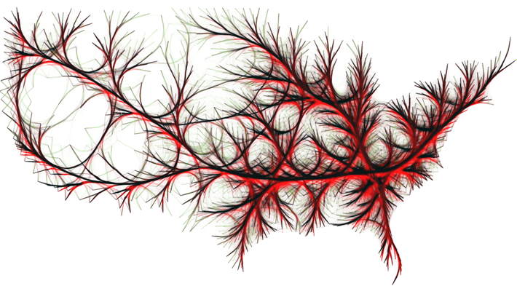
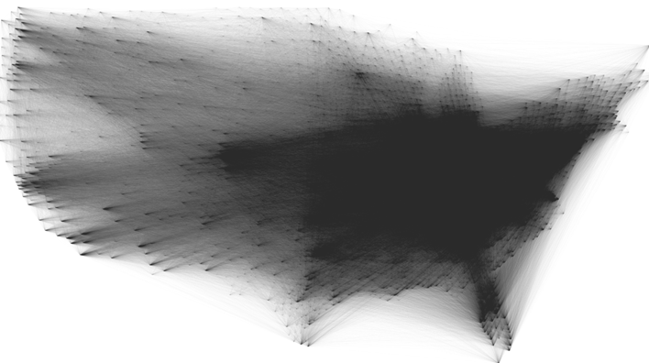
Edge Bundling definitions
Edge bundling techniques trade clutter for overdraw by routing related edges along similar paths.
Bundling can be seen as sharpening the edge spatial density, by making it high along bundles and low elsewhere.
Bundling improves readability for finding node-groups related to each other by edge-groups (bundles) which are separated by white space.

Slide 29
Hierarchical Edge Bundles: Visualization of Adjacency Relations in Hierarchical Data
Danny Holten. 2006. IEEE Transactions on Visualization and Computer Graphics 12, 5 (September 2006), 741-748.
Notes:
Hierarchical Edge Bundling (HEB) bundles edges together
by bending each edge, modeled as a B-spline curve,
toward the polyline path defined by the available hierarchy
[Hol06]. This method is not applicable to general graphs,
since it requires a graph to contain a hierarchy.

Slide 30
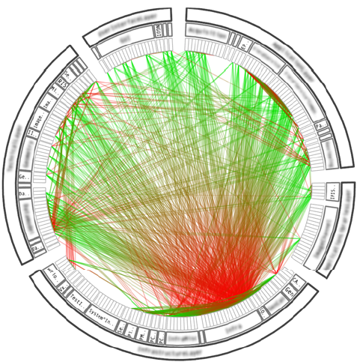
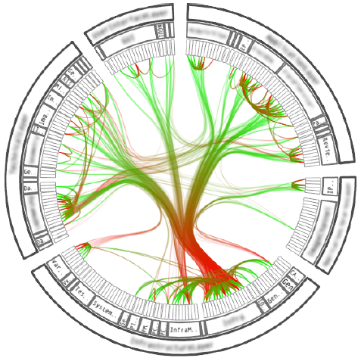
A software system and its associated call graph (caller = green, callee = red). (a) and (b) show the system without bundling using a radial and a squarified treemap layout (node labels disabled), respectively.
[Holten Infovis 2006]

Slide 31
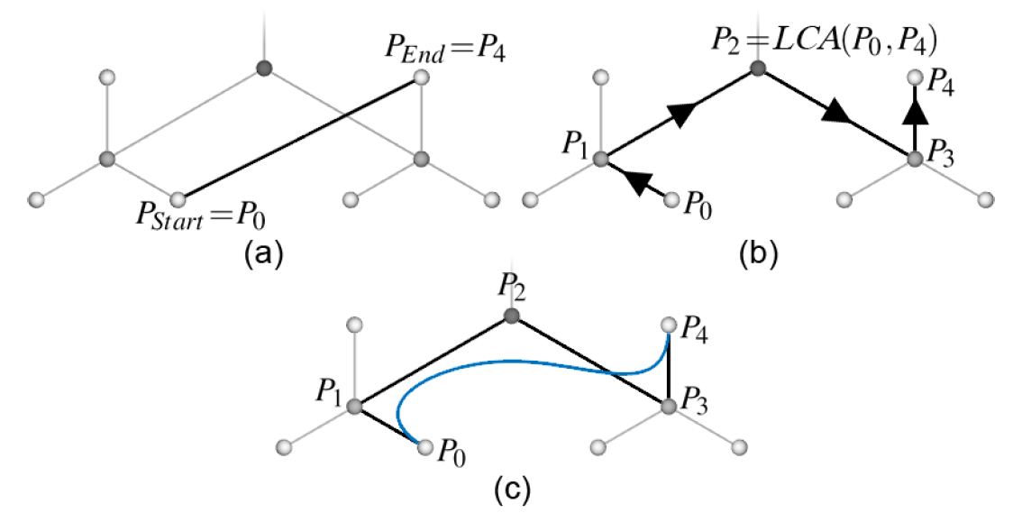
Hierarchical Edge Bundles principle
The approach is to use the path along the hierarchy between
two nodes having an adjacency relation as the control polygon of a
spline curve; the resulting curve is subsequently used to visualize the
relation.
[Holten Infovis 2006]

Slide 32
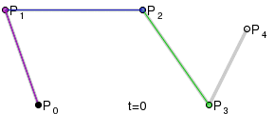
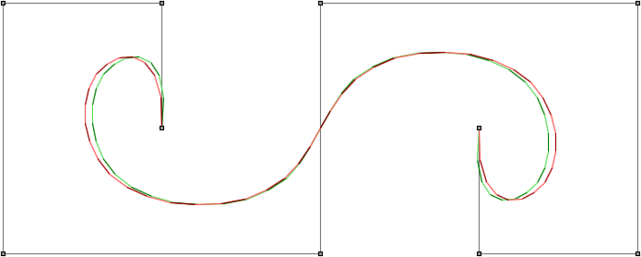
Spline computation Demo
B-spline
[B. A. Barsky. The Beta-Spline: A Local Representation based on Shape Parameters and Fundamental Geometric Measures. PhD thesis, University of Utah, 1981]

Slide 33
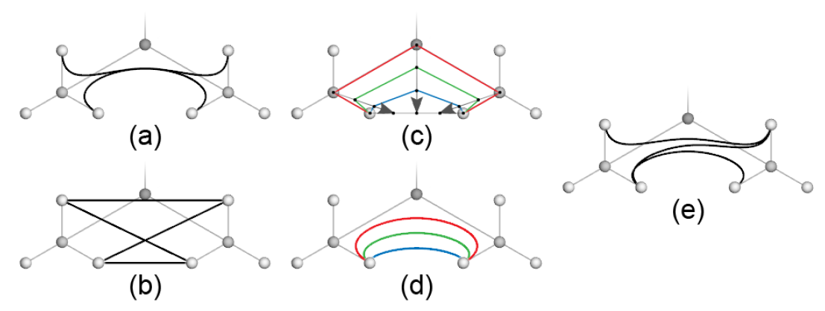
Resolving ambiguity
The bundle in (a) might contain each edge depicted in (b).
(c) and (d) show how different values of spline curves can be used.
As shown in (e), a fairly high bundling strength (b = 0.8) can be chosen to retain visual bundles while still resolving ambiguity.
[Holten Infovis 2006]

Slide 34
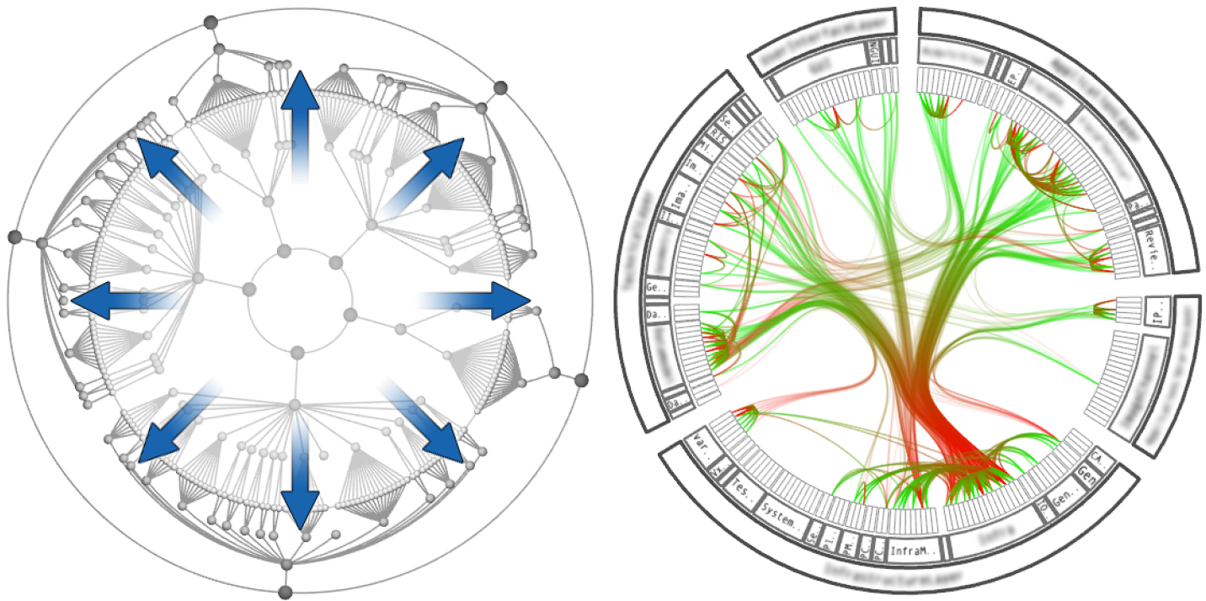
Radial layout construction. A radial tree layout is used for the inner circle and subsequently mirrored to the outside;
the inner layout is hidden and its structure is used to guide the adjacency edges.
[Holten Infovis 2006]

Slide 35
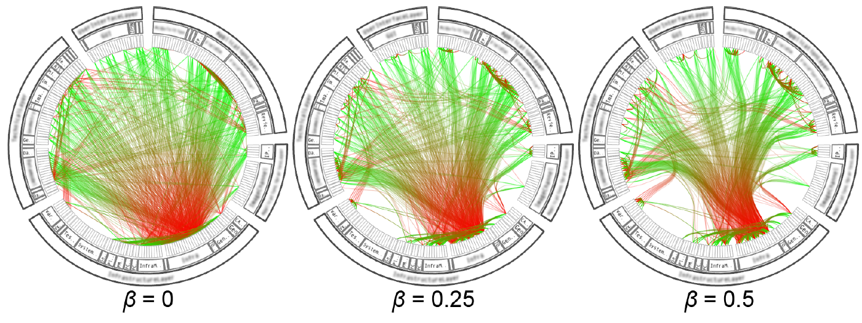
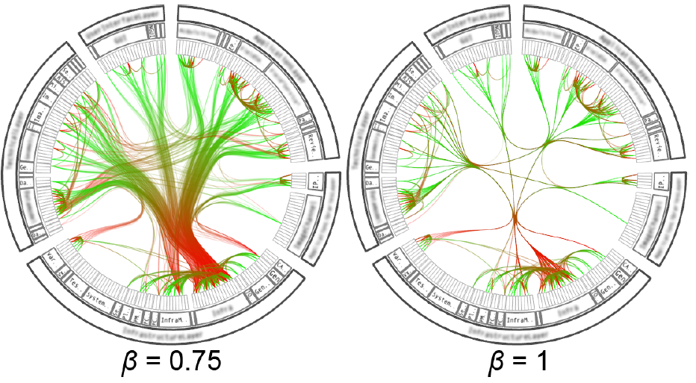
[Holten Infovis 2006]

Slide 36
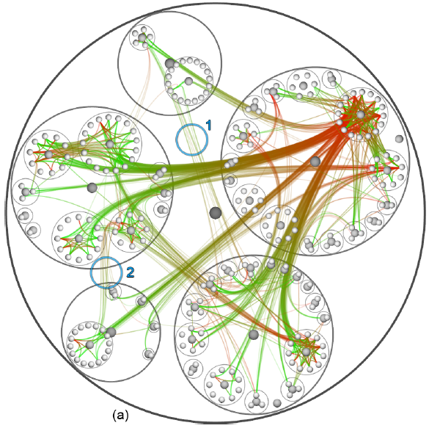
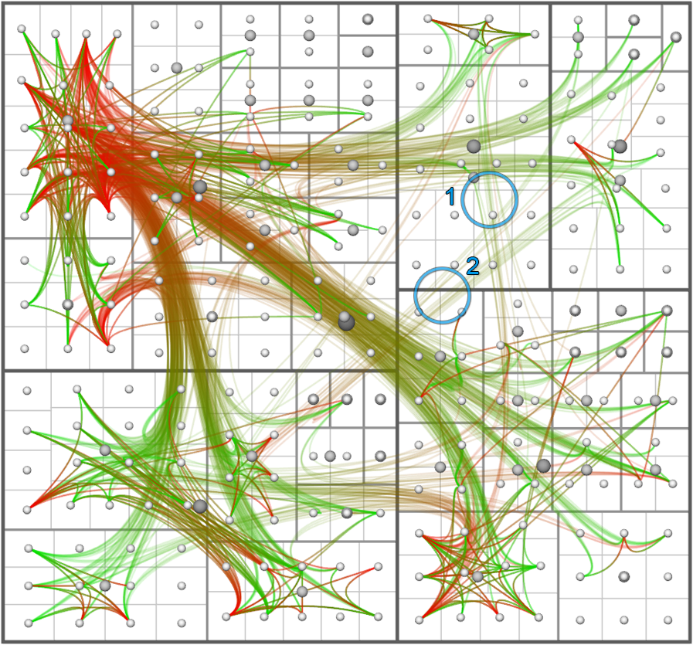
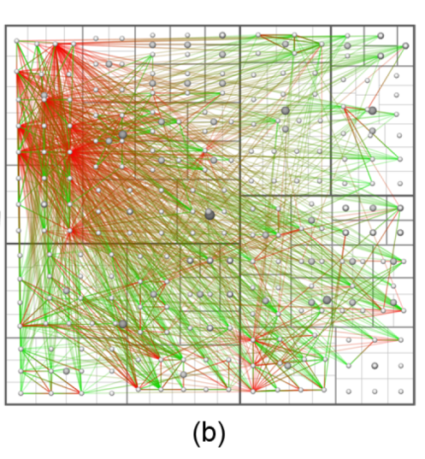
Hierarchical Edge Bundling with different graph layout
(Balloon, Treemap)
[Holten Infovis 2006]
Notes:
Hierarchical Edge Bundling (HEB) bundles edges together
by bending each edge, modeled as a B-spline curve,
toward the polyline path defined by the available hierarchy
[Hol06]. This method is not applicable to general graphs,
since it requires a graph to contain a hierarchy.

Slide 37
Geometry-Based Edge Clustering for Graph Visualization
Weiwei Cui, Hong Zhou, Huamin Qu, Pak Chung Wong, and Xiaoming Li
InfoVis 08

Slide 38
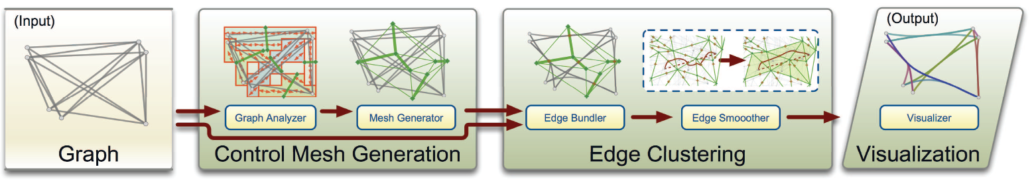
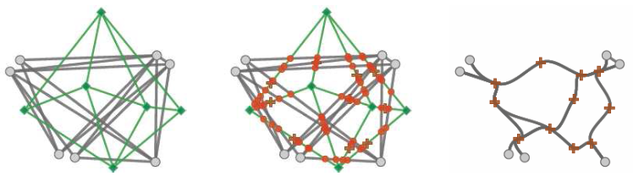
Control meshes are used to route curved edges
Control points: center of the intersection of graph edges and mesh
[Cui et al. Infovis 08]
Notes:
Cui et al. propose a Geometry-Based Edge
Bundling (GBEB) method suitable for general graphs
[CZQ08]. GBEB is partially based on previous work by
Zhou et al. and Qu et al. and relies on the generation of a
control mesh to guide the bundling [QZW06,ZYC08].
[QZW06] QU H., ZHOU H., WU Y.: Controllable and Progressive
Edge Clustering for Large Networks. In Proc. of the 14th
Int. Symposium on Graph Drawing (2006), pp. 399–404.
[ZYC08] ZHOU H., YUAN X., CUI W., QU H., CHEN B.:
Energy-Based Hierarchical Edge Clustering of Graphs. In
Proc. of the 2008 IEEE Pacific Visualization Symposium (2008),
pp. 55–62.

Slide 39
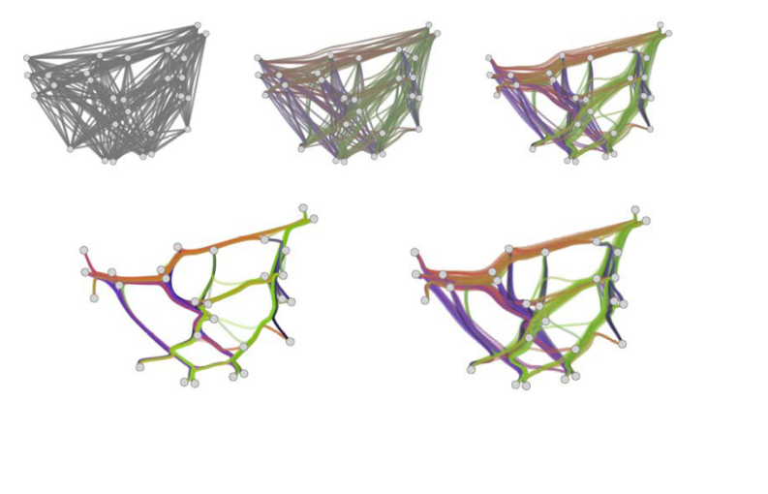
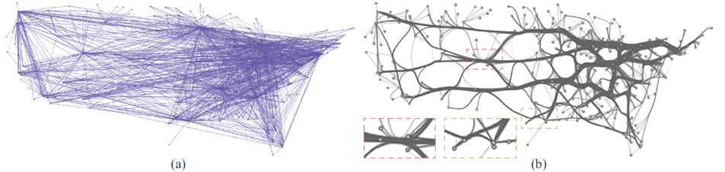
[Cui et al. Infovis 08]
Notes:
Cui et al. present a GBEB method suitable for general
graphs [CZQ08]. However, their method relies on
the generation of a control mesh to guide the bundling,
which frequently results in bundles that display considerable
curvature-variation. This can make such bundles hard to follow
(see Section 4.2).

Slide 40
Winding Roads Routing edges into bundles
A. Lambert and R. Bourqui and D. Auber Eurographics/ IEEE-VGTC Symposium on Visualization 2010
Notes:
Hierarchical Edge Bundling (HEB) bundles edges together
by bending each edge, modeled as a B-spline curve,
toward the polyline path defined by the available hierarchy
[Hol06]. This method is not applicable to general graphs,
since it requires a graph to contain a hierarchy.

Slide 41
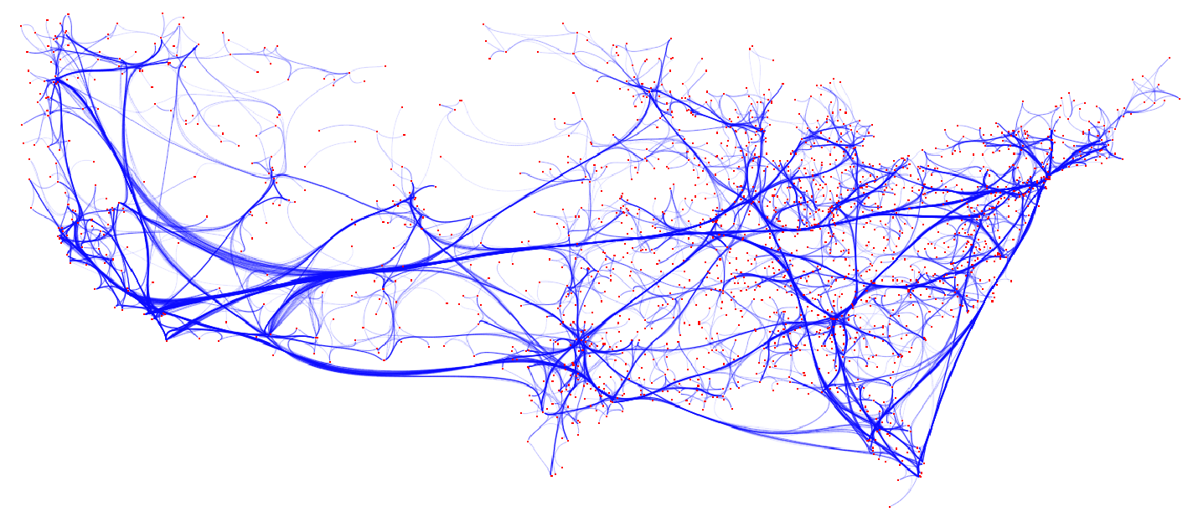
[A. Lambert et al. EuroVis 2010]
Notes:
The main idea of this technique is to use edge routing to bundle edges. First create a grid (hybride between quad tree and voronoi diagramm) and use the shortes path to connect odes on the grid.
Finally use the corner of the grid as control points of splines.

Slide 42
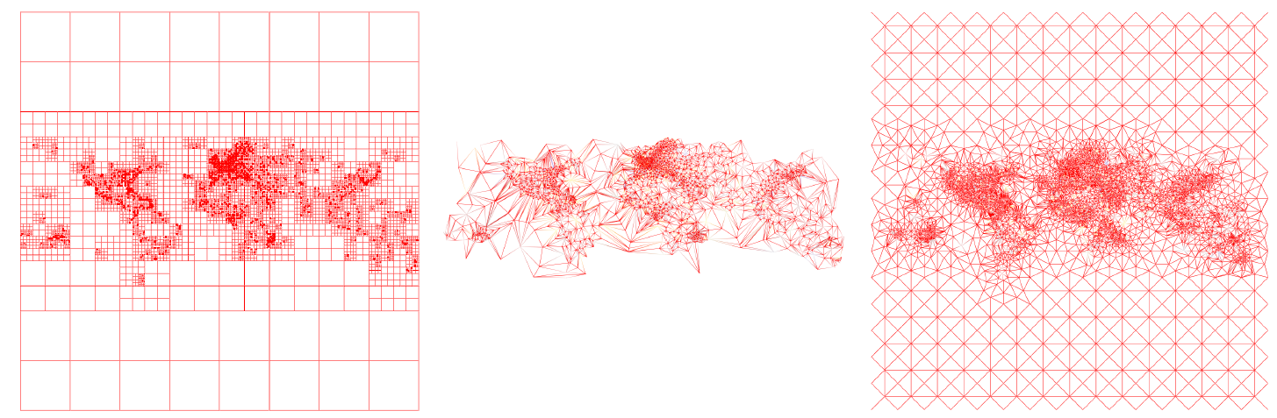
[A. Lambert et al. EuroVis 2010]
c
a
b
Grid graphs generated on the 2000 Air Traffic (AT) network with
(a) a quad tree (37395 nodes/69102 edges),
(b) A Voronoi diagram (4531 nodes/13558 edges)
(c) the hybrid quad tree/Voronoï approach (10146 nodes/30315 edges).
Notes:
Quad tree are fast but produice vertical an dhorizontal path.
Vonroid diagram can produice overlap (easy to fix), but produice large area without path

Slide 43
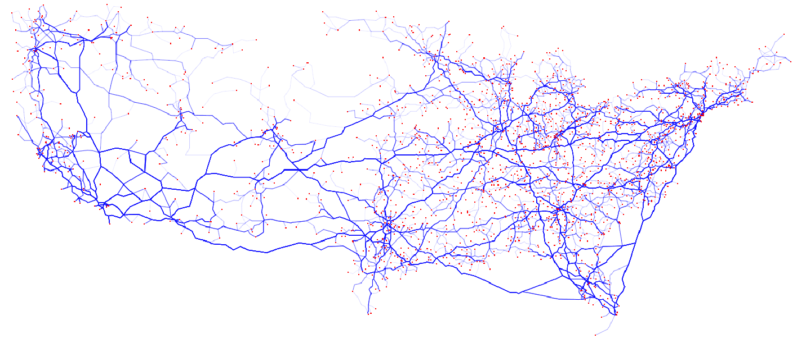
a) Edges are drawn as polylines
(b) Edges are drawn as Bézier curves
[A. Lambert et al. EuroVis 2010]
Notes:
Comparison between two representations of an edge-bundled graph. In (a), edges are drawn as polylines while in (b)
they are drawn as Bézier curves. When edges are rendered as Bézier curves, their shapes are smooth and a nice impression of
flows between different regions of the graph emerges from the drawing. However, edges can overlap nodes due to the lack of
local control proper to Bézier curves.

Slide 44
Force-Directed Edge Bundling for Graph Visualization
Danny Holten and Jarke J. van Wijk
Eurovis 2009

Slide 45
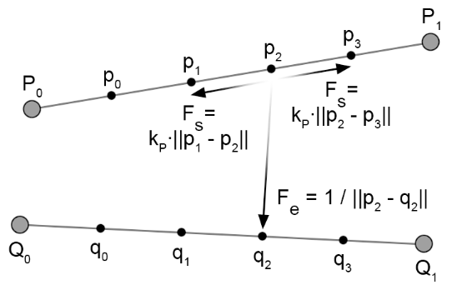
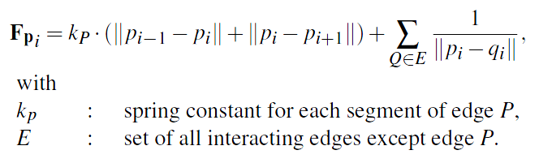
Force-Directed Edge Bundling: string and electrostatic force
Two interacting edges P and Q.
The spring forces Fs and the electrostatic force Fe that are exerted on subdivision point p2 by p1, p3, and q2 are shown.
[Holten and Wijk EuroVis 2009]
Notes:
Fe could also be calculated for each combination of subdivision
points (p;q) with p 2 P and q 2 Q. However, this
significantly increases the computational complexity from
O(N) to O(N2) for the interaction between a pair of edges
with N subdivision points per edge. Furthermore, we have
observed that both approaches do not differ much from a
visual point of view. We therefore chose the least computationally
expensive approach.

Slide 46
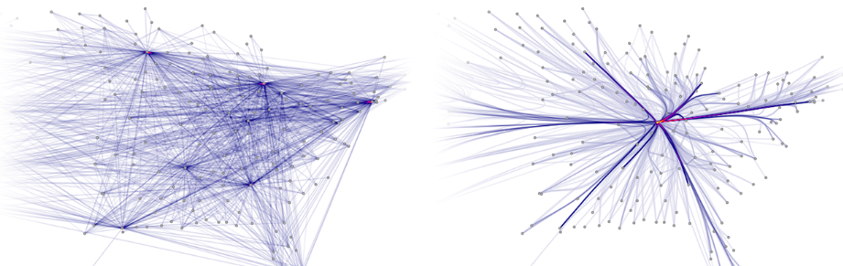
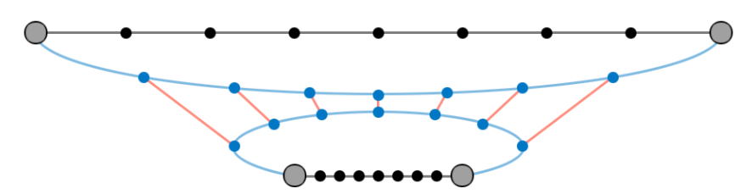
Main issues
Initial algorithm produces edge-bundled graph, but the amount of bundling is often too high:
Bundling edges that differ considerably in length can result in noticeable stretching and curving of short edges. Original edges, curved edges and attracting forces are shown in black, blue, and red, respectively.
[Holten and Wijk EuroVis 2009]

Slide 47
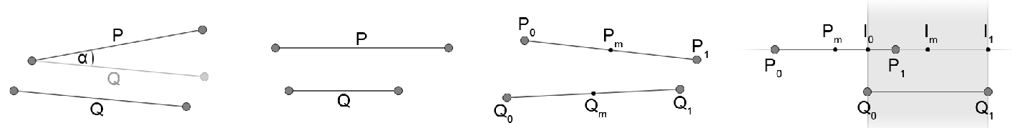
Solution: edge compatibility
Angle compatibility
Scale compatibility
Position compatibility
Visibility compatibility
[Holten and Wijk EuroVis 2009]
Notes:
edges that are almost perpendicular should not be bundled together.
edges that differ considerably in length should not be bundled together either;
Edges that are far apart should not be bundled together either (position compatibility).
However, it is possible that edges are parallel, equal in length, and close together, but should nevertheless have a fairly low bundling-compatibility.(visibility compatibility)

Slide 48
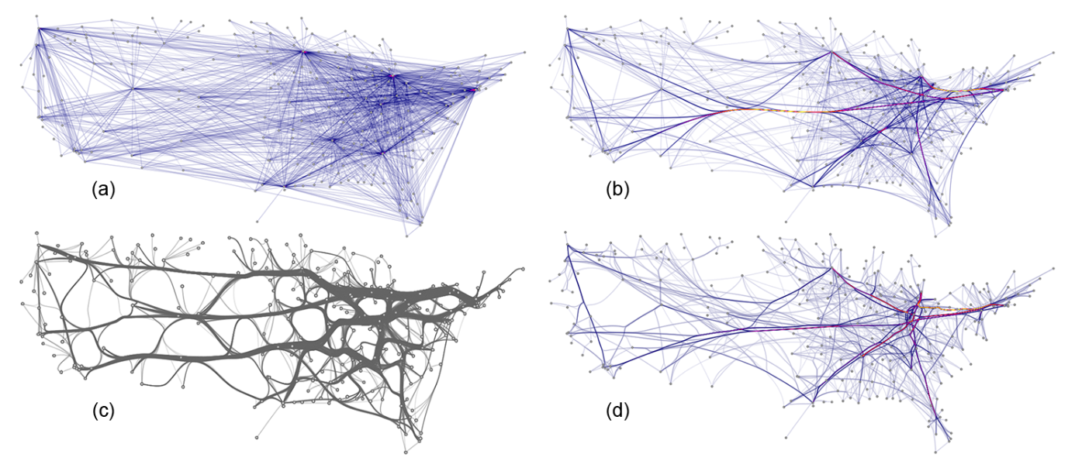
 | Air Line graph
FDEB | 18.8 s
GBEB | 2.5 s
US airlines graph (235 nodes, 2101 edges)
(a) not bundled and bundled using (b) FDEB with inverse-linear model,
(c) GBEB, and (d) FDEB with inverse-quadratic model.
[Holten and Wijk EuroVis 2009]
Notes:
Mingle

Slide 49
SideKnot: Revealing Relation Patterns for Graph Visualization
Dichao Peng Neng Lu Wei Chen Qunsheng Peng PacificVis 2012

Slide 50
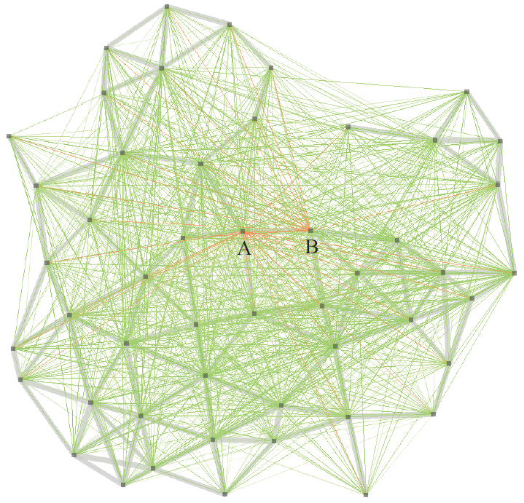
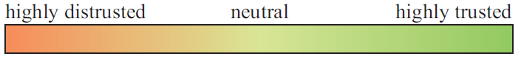
SideKnot: Revealing Relation Patterns for Graph Visualization Dichao Peng Neng Lu Wei Chen Qunsheng Peng
Original unbundled graph of 2263 trust relations between 50 nodes in a wireless network.
The grey grids in the background shows wireless connectivity between the nodes, while the colored lines are their trust relations established upon packet transmission along the wireless links.
The lower color gradient bar is used to encode the low-to-high trust level.

Slide 51
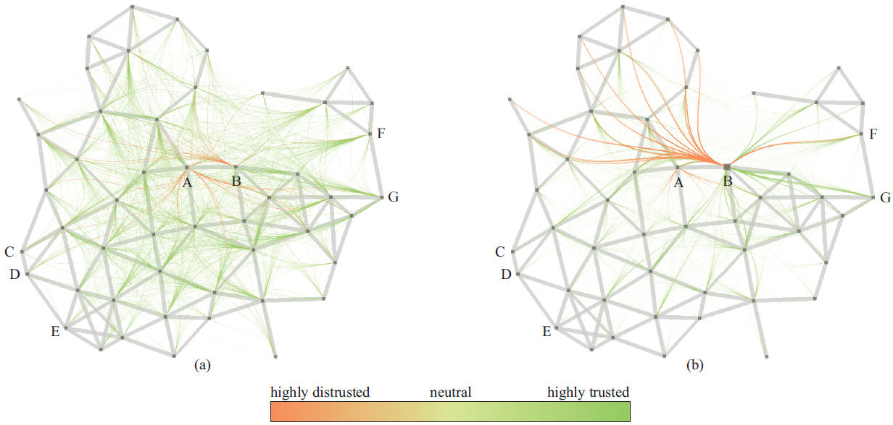
Bundled result for trust graph
Node B is selected by user and its trust relations get highlighted

Slide 52
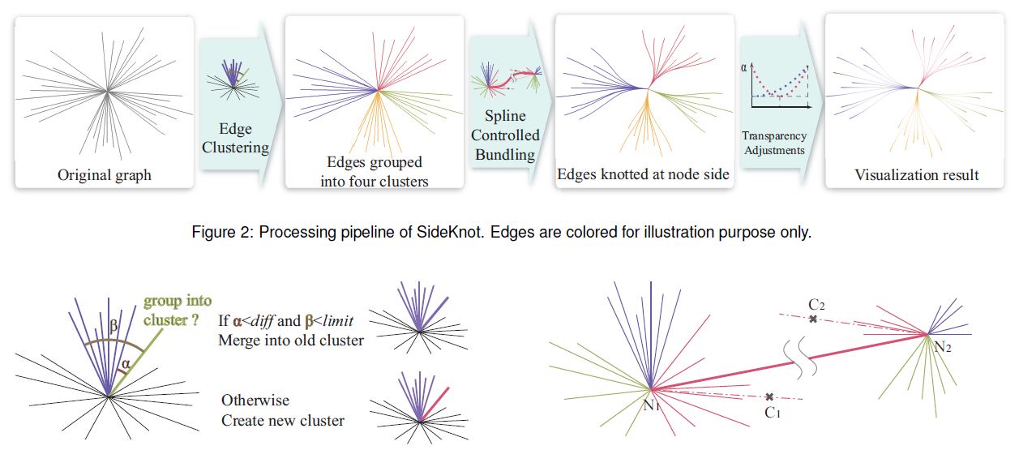
The SideKnot Algorithm
Notes:
Like HEB

Slide 53
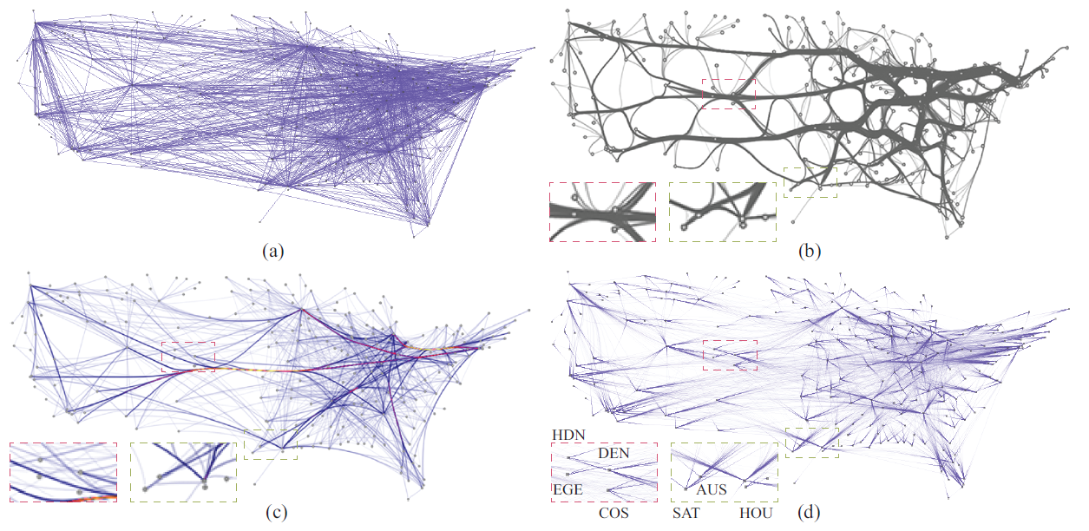
Edge bundling for U.S. airline route graph.
Original graph with 235 nodes and 2101 edges.
Bundled with GBEB
Bundled with FDEB.
Bundled with our method. Our visualization shows a number of middle-western cities (e.g. HDN, EGE, DEN, COS and more) have more routes to the east than to the west, suggesting their stronger connections with the eastern part of U.S

Slide 54
Multilevel Agglomerative Edge Bundling for Visualizing Large Graphs
Emden R. Gansner Yifan Hu Stephen North Carlos Scheidegger PacificVis 2011
Notes:
Goal:
No mesh control: no high varaition curature
No all to all force
No compatibility high computation

Slide 55
Ink ratio
“Data graphics ( Data Visualization ) visually display measured quantities by means of the combined use of points, lines, a coordinate system, numbers, symbols, words, shading, and color.”
Edward R. Tufte
Notes:
Bundling is a Graphical type of Data Visualization, According to tufte…..
Creating a data visualization is more than simply translating a table of data into a visualization. Data visualizations should communicate
data in the most effective way; to truly reveal the data they should be quick, accurate, and powerful. Creating visuals can easily summarize and communicate data to other people making even the largest or most complicated sets of data understandable.

Slide 56
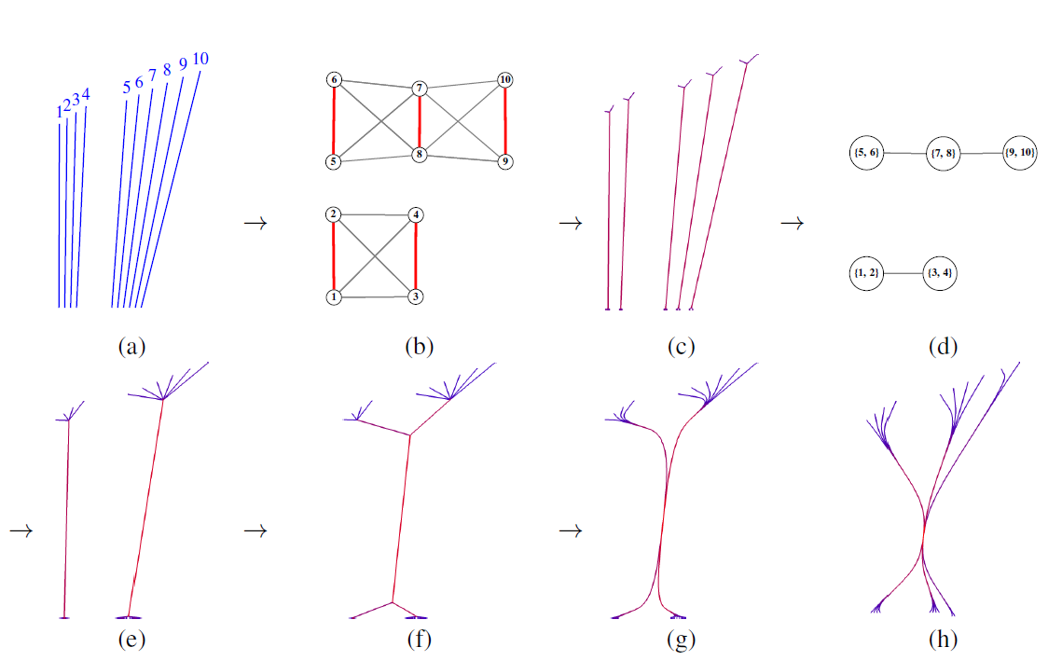
[Emden et at. 2011]
Notes:
Figure 1: How multilevel agglomerative bundling works:
Original edges. Ink = 35.82.
(b) Constructing an edge proximity graph (k = 3).
(c)After one level of agglomerative bundling. Ink = 19.31.
(d) Constructing a coarsened proximity graph.
(e) After multilevel agglomerative bundling.
Ink = 12.00. We call the tree-like branching portions of the bundles at their endpoints the fan-in and fan-out.
(f) After recursive application of bundling. Ink = 10.94.
(g) Rendered using splines.
(h) With turning angle <= 40o and spline rendering. Ink = 15.24.

Slide 57

(a) Graph airlines
(b) Bundled without recursion
[Emden et at. 2011]
(c) With recursion.

Slide 58


[Emden et at. 2011]
University of Florida Sparse Matrix Collection. http://www.cise.ufl.edu/research/sparse/matrices/

Slide 59


Net50, 429 760 edges (87 sec)
[Emden et at. 2011]
Notes:
Dataset: optimisation problem

Slide 60
Divided Edge Bundling for Directional Network Data
David Selassie, Brandon Heller and Jeffrey Heer Infovis 2011
Notes:
Goal:
No mesh control: no high varaition curature
No all to all force
No compatibility high computation

Slide 61

[Selassie et at. 2011]
Notes:
Graph of follower of GitHub: source code repository
Use the edge direction and weight

Slide 62


Notes:
Contribution:
Renamed the FDEB force:
Spring force the inner force within edges. -> Hooke’s law
Coulombic frce: the attraction force between edges -> Coulomb's inverse-square law is a law of physics describing the electrostatic interaction

Slide 63

Edge Routing with Ordered Bundles
Sergey Pupyrev, Lev Nachmanson, Sergey Bereg, and Alexander E. Holroyd
Graph Drawing 2012
Notes:
We propose a new approach to edge bundling. The approach starts by
routing the edge paths to minimize a weighted sum of the total length of the paths
together with the ink required to draw them. As this problem is NP-hard, we
provide an efficient heuristic that finds an approximate solution. Our approach
continues by separating edges belonging to the same bundle. To achieve this,
we provide a new and efficient algorithm that solves a variant of the
metro-line crossing minimization problem.
Table 2 shows the CPU times of algorithm steps. As can be seen, ordered bundles
can be constructed for graphs with several thousand of nodes and edges in less than a
minute.

Slide 64
Sum it up!
Holten bundled edges in compound graphs by routing edges along the hierarchy layout using B-splines [HEB].
Control meshes are used to route curved edges, a Delaunay-based extension called geometric-based edge bundling (GBEB).
Winding roads’ (WR) which use Voronoi diagrams for 2D and 3D layouts.
Force-directed edge bundling (FDEB) creates bundles by attracting edge control points, and was adapted to separate opposite-direction bundles [Divided edge bundling for directional network data].
The MINGLE method uses multilevel clustering to accelerate the bundling process.
Edge Routing uses optimization to produce bundles

Slide 65
Part II: EDGE SET SIMPLIFICATION Geometry LeveL Interaction
WHEN?
Data Level (Filtering)
Geometry Level (Mapping)
Image Level (Rendering)
Detection
HOW?
Reduction
Interaction
Notes:
Clustering methods
Interactive methods
Filtering methods

Slide 66

EdgeLens: an interactive method for managing edge congestion in graphs
Wong, Nelson and Carpendale, Sheelagh and Greenberg, Saul Infovis2003
Interaction-based techniques such as EdgeLens and Edge Plucking can be used to curve graph edges away from a user’s focus of attention without changing node positions.
Notes:
Interaction-based techniques such as EdgeLens and Edge Plucking can be used to curve graph edges away from a user’s focus of attention without changing node positions.
Video

Slide 67


Fisheye Tree Views and Lenses for Graph Visualization
Christian Tominski, James Abello, Frank van Ham, Heidrun Schumann
IV 2006
Notes:
Hans paper:
Gpu technique, pixel based with the stensil buffer.
Before rendering

Slide 68


MoleView: An Attribute and Structure-based Semantic Lens for Large
C. Hurter, O. Ersoy, A. Telea
Infovis 2011

Slide 69


Demo: Bundle-based exploration
[Hurter et al. Infovis 2011]
Notes:
principle of MoleView:
As input, we consider a dataset D = fsig consisting of a set of data elements si
which all have 2D layout positions L=fpi =(xi;yi) 2 R2g. Examples
thereof are scatter plots, where si are data points; images, where si are
pixels with color information; and node-link graph drawings, where
si are nodes, edge control points, entire edges, or entire edge bundles.
Any other dataset can be considered as long as it provides 2D position
information. Within the given layout, the positions of different
elements can overlap, e.g. in the case of (bundled) graph drawings (in
which case clutter and overdraw are an issue), or not e.g. in the case
of images. Each si can have an application-specific attribute vector
vi = fvi

Slide 70

[Hurter et al. Infovis 2011]

Slide 71
Exploring the Design Space of Interactive Link Curvature in Network Diagrams
Nathalie Henry Riche, Tim Dwyer, Bongshin Lee ,Sheelagh Carpendale AVI 2012

Slide 72



[Henry Riche et al. AVI 2012]
Notes:
Video

Slide 73


Slide 74


Slide 75


Slide 76


Slide 77

Edge Compression Techniques for Visualization of Dense Directed Graphs
Tim Dwyer, Nathalie Henry Riche, Kim Marriott, and Christopher Mears Infovis 2013

Slide 78


Ambiguity-Free Edge-Bundling for Interactive Graph Visualization
Sheng-Jie Luo, Chun-Liang Liu, Bing-Yu Chen, and Kwan-Liu Ma
TVCG 2012
Notes:
In this paper, we present an ambiguity-free edge-bundling method especially for improving local detailed
view of a complex graph. Our method makes more efficient use of display space and supports detail-on-demand viewing through an
interactive interface.
Video

Slide 79
Part II: EDGE SET SIMPLIFICATION Image Level
WHEN?
Data Level (Filtering)
Geometry Level (Mapping)
Image Level (Rendering)
Thanks to the recent improvements regarding graphic hardware and its flexible usage, image level methods are nowadays very popular. Graphic cards can be used to improve rendering aesthetics and to address scalability issues.
Notes:
Clustering methods
Interactive methods
Filtering methods

Slide 80
Hierarchical Edge Bundles: Visualization of Adjacency Relations in Hierarchical Data
Danny Holten. 2006. IEEE Transactions on Visualization and Computer Graphics 12, 5 (September 2006), 741-748.
Notes:
Hierarchical Edge Bundling (HEB) bundles edges together
by bending each edge, modeled as a B-spline curve,
toward the polyline path defined by the available hierarchy
[Hol06]. This method is not applicable to general graphs,
since it requires a graph to contain a hierarchy.

Slide 81

Pixel based technique to distinguish individual curves or subbundles within a bundle
(a) Alpha blending disabled
(b) Alpha blending enabled
Holten Infovis 2006

Slide 82

Pixel based technique
Using OpenGL’s EXT blend minmax extension:
(a) and (b) show normal alpha blending
(c) and (d) show the usage of standard MIN EXT (minimum) and MAX EXT (maximum) blending
(e) shows a transparency mask generated using normal alpha blending
f) and (g) show how this provides these results with additional levels of opacity
Notes:
Using OpenGL’s EXT blend minmax extension. (a) and (b) show normal alpha blending on a white and black background, respectively;
(c) and (d) show the usage of standard MIN EXT (minimum) and MAX EXT (maximum) blending, respectively. An individual curve within the bundle
having an opposite direction can easily be discerned; (e) shows a transparency mask generated using normal alpha blending, which can be
combined with the results depicted in (c) and (d); (f) and (g) show how this provides these results with additional levels of opacity (as is the case
with standard alpha blending as depicted in (a) and (b)). The transparency mask furthermore allows them to be combined with other background
colors than black and white. This combines the benefits of normal alpha blending and standard MIN EXT and MAX EXT blending.

Slide 83
Winding Roads Routing edges into bundles
A. Lambert and R. Bourqui and D. Auber Eurographics/ IEEE-VGTC Symposium on Visualization 2010
Notes:
Hierarchical Edge Bundling (HEB) bundles edges together
by bending each edge, modeled as a B-spline curve,
toward the polyline path defined by the available hierarchy
[Hol06]. This method is not applicable to general graphs,
since it requires a graph to contain a hierarchy.

Slide 84

[A. Lambert et al. EuroVis 2010]
Notes:
Density computation with GPU Accumulation buffer (render to tecture Frame buffer object)

Slide 85

[A. Lambert et al. EuroVis 2010]
Notes:
Bump mapping

Slide 86
Image-Based Edge Bundles: Simplified Visualization of Large Graphs
A. Telea and O. Ersoy
Eurovis 2010
Notes:
Hierarchical Edge Bundling (HEB) bundles edges together
by bending each edge, modeled as a B-spline curve,
toward the polyline path defined by the available hierarchy
[Hol06]. This method is not applicable to general graphs,
since it requires a graph to contain a hierarchy.

Slide 87

Image-Based Edge Bundles: Simplified Visualization of Large Graphs
Notes:
We present a new approach aimed at understanding the structure of connections in edge-bundling layouts. We
combine the advantages of edge bundles with a bundle-centric simplified visual representation of a graph’s structure.
For this, we first compute a hierarchical edge clustering of a given graph layout which groups similar edges
together. Next, we render clusters at a user-selected level of detail using a new image-based technique that combines
distance-based splatting and shape skeletonization. The overall result displays a given graph as a small set
of overlapping shaded edge bundles. Luminance, saturation, hue, and shading encode edge density, edge types,
and edge similarity. Finally, we add brushing and a new type of semantic lens to help navigation where local
structures overlap. We illustrate the proposed method on several real-world graph datasets.

Slide 88



Slide 89
Part II: EDGE SET SIMPLIFICATION Geometry LeveL Using Image Level
WHEN?
Data Level (Filtering)
Geometry Level (Mapping)
Image Level (Rendering)
Notes:
Clustering methods
Interactive methods
Filtering methods

Slide 90

SBEB Skeleton-based Edge Bundling
O. Ersoy, C. Hurter, F. V. Paulovich,
G. Cantareira, A. Telea Infovis 2011
Notes:
Hierarchical Edge Bundling (HEB) bundles edges together
by bending each edge, modeled as a B-spline curve,
toward the polyline path defined by the available hierarchy
[Hol06]. This method is not applicable to general graphs,
since it requires a graph to contain a hierarchy.

Slide 91
Edge Bundling
Node-link diagrams are widely used
Large number of nodes + edges = visual clutter!
Edge bundling,
draws related edges close to each other increases white space between bundles.
trades clutter for overdraw
This technique is applicable to general graphs
(no hierarchy required)
Notes:
Node-link diagrams is an effective way of showing scientific data, and they are widely used.
However when there are large number of nodes and edges, we face the problem of visual clutter.
Edge bundling is one of the techniques to overcome this problem.
Edge bundling techniques in general, draw related edges close to each other.
This way they increase the white space between the formed bundles.
We may say, it trades clutter for overdraw, as you can see in this small example from Danny Holten’s Hierarchical Edge Bundling paper.

Slide 92

Our Idea: Use Skeletons
The skeleton,
is nicely centered in the shape
obeys the shape’s topology (branches, loops, etc)
“Use skeletons to direct edge bundling”
Notes:
In our previous study, named Image-based Edge Bundling, we made use of skeletons to render the prebundled edges.
There we observed that skeletons are nicely centred in the shape, or bundles.
They obey the shape’s topology, following the branches and loops.
And we came up with the idea of using skeletons for the edge bundling itself, rather than just rendering them.

Slide 93





Skeleton-based Edge Bundling
At each iteration:
cluster the edges,
Then for each cluster:
inflate + threshold edges to get a thin shape Ω using DT,
compute the skeleton S_{Ω},
compute the feature transform FT_{S},
attract the edges to S_{Ω} using FT_{S}
Notes:
Our method follows an iterative processing.
At each iteration,
We first cluster the edges, using hierachical bottom-up agglomerative clustering, with full linkage and euclidian distance.
Then for each cluster,
We first inflate and threshold its edges using distance transforms, to obtain a nice shape that encloses the edges of the cluster.
Next we compute the skeleton of this shape, using GPU implementation of the AFMM method.
And also the feature transform of the skeleton. Here feature transform of the skeleton gives us the closest skeleton point for each point on the image, or the edges.
Finally we attract the edges to the skeleton, using this feature transform.
The details of the method are as follows,
- First we cluster the edges -> Cluster 3.0, hierarchical bottom-up agglomerative clustering + full linkage + euclidian distance,
groups same-direction + spatially close edges
Then for each cluster we do the following
First we inflate the edges of the cluster to get a thin shape that encloses all the edges of the cluster (gives similar results to splatting, but faster)
Next we compute the skeleton of the shape
And the feature transform of the skeleton using AFMM (augmented fast marching method) (same color regions -> Voronoi regions of the skeleton branches)
Here we use a GPU based implementation of the AFMM method
Finally we attract edges to the skeleton using this feature transform

Slide 94
Edge Attraction: Singularities
When we attract all edge points to their closest skeleton point, singularities appear
The singularities cause undesired kinks
Notes:
However, attracting all edge points to their closest skeleton points, causes some problems.
Take a look at this figure.
Here black curves show the computed skeleton, and the green curve is our edge.
For the orange part seen in the figure, if we attract the points here to their closest skeleton points, we get this undesired kink on the attracted edge.

Slide 95
Edge Attraction: Singularities
For edge attraction:
compute all branch termination points, i.e. tips
compute all skeleton paths
for each edge, select a skeleton path passing through the FT_{S} of both edge end points
move all edge points towards the selected path
Notes:
To overcome this problem, we do the following.
We first compute all skeleton branch termination points.
Then we compute all skeleton paths, connecting any two of these termination points.
And for each edge, select a skeleton path, that passes through the feature transform of both edge end points, shown here with yellow dots.
Then we move the edge points towards the selected skeleton path.
If the feature transform of an edge point is not on the selected skeleton path, we assign one, and attract the points towards this point.
This way, we manage to get rid of the undesired kinks.

Slide 96

Post-processing
Edge smoothing
Each point is moved towards the average of its neighboring points
Removes sharp bundle turns
Notes:
Our produced bundles tend to have a strong branching structure.
We introduce two post-processing steps, to let the used get their desired structured look.
First one is edge smoothing.
Here each edge points is moved towards the average of its neighbouring points.
This helps the user to remove sharp bundle turns, if they are not desired.

Slide 97

Post-processing
Edge relaxation
Edges are interpolated between their final positions and initial positions
Shows individual edges within a bundle and where they come from
Notes:
Our second post-processing step is edge relaxation.
Edges are interpolated between their initial and final, or bundled, positions.
This helps the user to see individual edges within a bundle and where they come from.
But we want to remark that exploration is not the core of this study.
Actually we have another work, named MoleView, that will be presented on Friday at 8:30 at Multidimensional visualization session of InfoVis.
Moleview aims to explore the bundling effect in a given layout, and many more.

Slide 98

Rendering
We use a 3D cushion profile: bright at the bundle’s center, dark at the boundary
Set the saturation and brightness of edge points based on distances to the skeleton
Notes:
For the rendering, we apply a simple cushion profile, which provides a bright view at the bundle centers and dark at the boundaries.
To do this, we set the saturation and brightness of the all edge points based on distances to their skeleton.
Here you see an example for the effect of this cushion profile.
It helps us to visually better separate the bundles, especially at the overlapping regions.

Slide 99


US Migrations, 1715 nodes, 9780 edges, 6 clusters, 4.1 sec.
Notes:
Our third example is US migrations dataset. Here the nodes show the cities and edges show the moving population between these cities.
In this graph we have less number of clusters, compared to previous examples.
The method helps us to see the patterns of the connections between east and west coast, and also dense pattern on the east coast within this huge green bundle.

Slide 100

Results
US Migrations, 1715 nodes, 9780 edges, 6 clusters, 4.1 sec.

Slide 101

Results
France Air, 34544 nodes, 17272 edges, 207 clusters, 29.2 sec.
Notes:
Our last example is France Air dataset.
Here, unlike previous examples, edges are not straight lines, but real trajectories, which show the routes of flights in one day over France.
Edge bundling helps us to see the patterns and the coarse level structure of the graph, grouping and drawing similar trajectories closer to each other.
However we lose the information encoded within the edges.
So if the edge placements have a spatial meaning, edge bundling might not always be the best choice for such graphs.

Slide 102

France Air, 34550 nodes, 17272 edges, 207 clusters, 29.2 sec.

Slide 103


Results
Radial, 1024 nodes, 4021 edges, 94 clusters, 7.4 sec.
Notes:
Our next example shows the dependency map of a software system. Here the nodes are software entities and links show the function calls.
This example is a good one to see the effect of edge bundling.
Edges are formed into bundles and white spaces introduced between the bundles to let us separate them visually.
As we said at the beginning, this trades clutter for overdraw, as you can see here.

Slide 104

Radial, 1024 nodes, 4021 edges, 94 clusters, 7.4 sec.

Slide 105
Skeleton-based Edge Bundling
Pros
Generality: No hierarchy required, applicable to general graphs, directed or undirected
Structured look control: Generates smooth or organic-looking bundles
Speed and simplicity: CUDA implementation, entirely image-based
Cons
Susceptible to clustering results
Notes:
Our method has its own strengths and weaknesses.
The strong sides of our method are as follows.
First of all, our method requires no hierarchy and applicable to general graphs.
It can work with both directed and undirected graphs.
To do this, the only thing we need to adjust is the clustering, which will group edges ignoring their directions.
Second, our method can create smooth or organic-looking bundles, depending on the user needs.
The user may adjust the structured look of the graph with smoothing and relaxation parameters.
Finally, since our method is totally image-based (that is apart from the clustering), it allows efficient implementation in graphics hardware.
The only known weakness of our method is that the method is highly susceptable to clustering results.
If the clustering doesn’t provide good results, the bundles our method will create won’t be much pleasing.

Slide 106


Graph Bundling by Kernel Density Estimation
C. Hurter, O.Ersoy, A.Telea Eurovis 2012
Notes:
Hierarchical Edge Bundling (HEB) bundles edges together
by bending each edge, modeled as a B-spline curve,
toward the polyline path defined by the available hierarchy
[Hol06]. This method is not applicable to general graphs,
since it requires a graph to contain a hierarchy.

Slide 107

An unbundled graph
Consider the edge density
it is relatively uniform

Slide 108

One bundling step
Edges get closer -> density gets sharpened

Slide 109

More bundling…
Edges get closer -> density gets sharper

Slide 110

Even more bundling…
Edges get closer -> density gets even sharper

Slide 111

Even more bundling…
Edges get closer -> density gets even sharper

Slide 112

Even more bundling…
Edges get closer -> density gets even sharper

Slide 113




KDEEB : Mean Shift and Bundling [1]
sharpening
edge density signal
unbundled graph
bundled graph
If bundling sharpens the edge density, then
sharpening the edge density should bundle
[1]Christophe Hurter, Ozan Ersoy, Alexandru Telea. Graph Bundling by Kernel Density Estimation. (EuroVis 2012). Computer Graphics Forum 31, 3pt1 (june 2012) p865-874.
Notes:
For the one of you that know image processing, note that what we are doing is nothing else than men shift segmentation technique but on pixel color, but on edges
Bundling
Mean shift : Dorin Comaniciu, peter Meer

Slide 114







KDEEB pipeline
Notes:
Three main steps

Slide 115




Step 1: Computing the density map
Initial graph
Density map
Efficient computation: graph edge splatting
Notes:
Kernel K (parabolic function) with a bandwith H
Mathemitacal formulation of the kenerl desity estimation

Slide 116


Step 2: Edge advection
Advected edges (iteration 1)
Initial graph
Move edges in the normalized gradient of the density map
Notes:
Delta is the gradient
H(t) is a factor that descreseas over time (less movements)

Slide 117

Step 3: Edge smoothing
Advected edges
Smoothed edges
Eliminates advection artifacts caused by
density map sampling (texture splatting)
edge sampling (polylines)

Slide 118

After n iterations
Original graph
Bundled graph
Edge bundles: asymptotically tend to Dirac-like impulses

Slide 119

Shading computation
Dot product

Slide 120


Demo

Slide 121

Comparison: Bundling style
we achieve same look-and-style as other methods
but we are much faster
Notes:
Force directed EB
Geometry based EB
Winding roads EB

Slide 122



Slide 123




Slide 124




Slide 125



Slide 126


Notes:
This example proves two points:
Scalability
Ability to declutter a very dense graph!

Slide 127




Comparison: MINGLE[1]
Yeast graph
6 646 edges
Net-50 graph
464 440 edges
[1] GANSNER E., HU Y., NORTH S., SCHEIDEGGER, C.: Multilevel agglomerative edge bundling for visualizing large graphs. In Proc. PacificVis (2011),
Notes:
Mingle: ink minisation: edge proximity graph
Yeast : biological application
Net-50: internet graph

Slide 128


Comparison: MINGLE
Wiki graph 100 762 edges
we produce less clutter than MINGLE
we achieve roughly the same speed for small dataset, but three time faster with big datasets
Notes:
Amazone : kdeeb : 58, Mingle: 157s
Wiki vote : kdeeb : 8s mingle: 6 s

Slide 129

Obstacle-constrained bundles
Why: avoid regions (labels, icons)
How: smoothly route bundles around obstacles of arbitrary geometry
Notes:
In our bundling, we moved edges towards high-density areas
Now, we show a variation of the same technique to produce bundled layouts that avoid obstacles

Slide 130


Obstacle-constrained bundles
Technique
Inflate the obstacle Ω

Slide 131

Obstacle-constrained bundles
Technique
Compute the feature transform FT_{Ω}
Find where the edges enter and exit the obstacle

Slide 132
Obstacle-constrained bundles
Technique
Replace edge segment with shortest path along boundary of Ω
Smooth resulting edges (constraining this outside Ω)
sharp bends

Slide 133


US Migrations Dataset
(a) without endpoint displacement
(b) with endpoint displacement

Slide 134

Graph Bundling by Kernel Density Estimation
Simple: image-based techniques (~500 LOC)
Fast: 5..20 faster than comparable methods
Additions: simple/generic obstacle avoidance
Notes:
Core implementation
Our pipeline is very simple (splatting/advection) -> we can potentielly change it to do application-specif bundling. For instance outer bundling…
With small algorithm modification, we can optain very different bundling effect (consider outer bundling > pushing edges). Now we want to explore other tasks wich require such special bundling effects.

Slide 135


Smooth Bundling of Large Streaming and Sequence Graphs
C. Hurter, O.Ersoy, A.Telea PacificVis 2013
Notes:
Hierarchical Edge Bundling (HEB) bundles edges together
by bending each edge, modeled as a B-spline curve,
toward the polyline path defined by the available hierarchy
[Hol06]. This method is not applicable to general graphs,
since it requires a graph to contain a hierarchy.

Slide 136


Graph visualization challenges
Show the structure in relational datasets
Show connectivity patterns
Show frequent communication path
Edge bundling on graph:
Show connectivity patterns
with a trade-off between clutter and overdraw

Slide 137
Bundling methods remains mainly used for static graph
Dynamic graph visualization challenges:
Larger data volumes than static graph
Show changes in the overall graph structure
Avoid abrupt changes in the graph layout
Design guide lines:
Use of graph interpolation
Use of KDEEB (Kernel Density Estimation Edge Bundling)

Slide 138
KDEEB Assets (Graph Bundling by Kernel Density Estimation)
Continuity (iteration = bundling strength)
Stability : mean shift[1] converges
Simplicity and speed
Implicit design
Conclusion:
KDEEB is ideal for bundling changing graphs
- Mouse bundling demo -
[1] D. Comaniciu and P. Meer. Mean shift: A robust approach toward feature
space analysis. IEEE TPAMI, 24(5):603–619, 2002.
Notes:
But the most important thing is the implicit design:
KDEEB can bundle, at a step, any graph (set of curves, actually) you plug into the method!
We don't need edge-correspondences (for KDEEB, that is, to work), or some preprocessing of the full sequence in advance, or clustering, or whatever:
we just bundle a set of curves.
So the key idea for bundling streaming graphs will be to LET THE BUNDLING-TIME (ITERATION) AND THE PHYSICAL TIME BE THE SAME.
most other bundling methods cannot do this.
Then, after you explain this, you can pass to slide 11, where you say something like "OK, so we have this observation that KDEEB seems ideally suited to bundle dynamic graphs; before we show how we do this, let's examine what kinds of dynamic graphs are out there; we identify two types of graphs... etc etc".

Slide 139

Animation with FDEB (Force Directed Edge Bundling)
(Video)
[Q. Nguyen, P. Edges, and S.-H. Hong. StreamEB: Stream edge
bundling. In Proc. Graph Drawing, pages 324–332, 2012]
Notes:
Show video FDEB first animation graph drawing 2012

Slide 140

[Hurter et al. PacificVis 2013]

Slide 141
Mouse trail Demo

Slide 142
Datasets Streaming and sequence graph
Streaming graph: temporally ordered, unstructured edge sequences (start, end, life time).
Sequence graph: discreet set of graphs with edge correspondence over time.
Notes:
First, streams allow defining an infinity of “instantaneous” graphs
In contrast, graph sequences contain a finite set of graphs which have been explicitly computed in specific ways

Slide 143




Aircraft trajectory streaming graph

Slide 144
Discussion
streaming graphs
Fits naturally to the KDEEB method
Set bundling time = physical time
Cannot be (easily) done with other bundling methods
sequence graphs
Need correspondence information
Can use other bundling methods than KDEEB
Main KDEEB asset: speed

Slide 145
Complexity
streaming graph visualization: O(E) per animation frame, where E is the average number of edges
sequence graph visualization: O(BN) for a sequence of N graphs, and a bundling algorithm of complexity B

Slide 146
Performance 2.3 GHz PC with 8 GB RAM, NVidia GT 480 card
Implementation C# and OpenGL 1.1, 2.3 GHz
US dataset (streaming graph): 0.05 seconds/frame (2K edges on average)
France dataset (streaming graph): 0.17 seconds/frame (15K edges on average)
we are roughly 10 times faster than the original KDEEB which is expected, as we do only one iteration per frame. the total time needed for a stream depends on the stream’s length.
In contrast, if we were to use FDEB (1.7 GHz PC ), we would
US dataset (streaming graph): 19 seconds/frame (2K edges on average)
Small graph: 6 seconds/frame (900 edges)
Notes:
with the conclusion that the method is highly SCALABLE as compared to other methods on the market! This is an important point, which we should emphasize!

Slide 147

Summary of contributions
Real time EB: image-based techniques
Simple: few parameters
Flexible: applicable on general graph
Scalable

Slide 148






Smooth Bundling of Large Streaming and Sequence Graphs
Christophe Hurter, Ozan Ersoy, Alexandru Telea
http://www.recherche.enac.fr/~hurter/KDEEB/
Visual Studio C# code instance (GPU version) Visual Studio C# code instance (CPU version),

Slide 149

Edge Bundling papers

